Slide 1
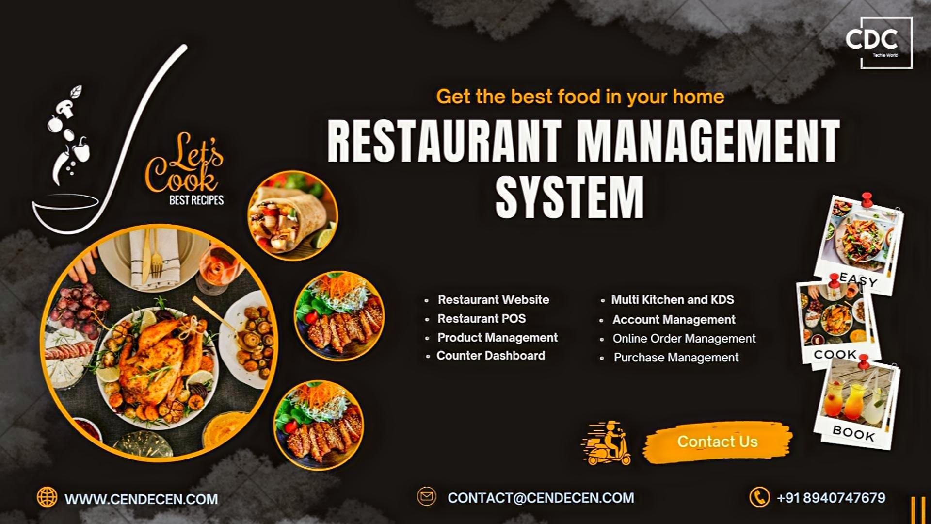
Restaurant Management System Scenario: Automate restaurant operations, including order processing and inventory management
Discover how C++ empowers the design and development of a comprehensive Restaurant management system, enable seamless management of restaurant activities.
192211802 | Kanakam Rakesh
192210323 | K.Akshay kumar

Slide 2
Introduction to Restaurant Management System
Restaurant Operations
Order Processing:
Inventory Management:
The modern food service industry demands a fast-paced and efficient workflow to meet customer expectations and stay competitive.
Monitors stock levels and alerts staff about low inventory.Tracks usage of ingredients to prevent wastage and ensure optimal stock utilization.
Simplifies the order-taking process for dine-in, takeaway, or online customers.Integrates with point-of-sale (POS) systems to process payments efficiently.

Slide 3
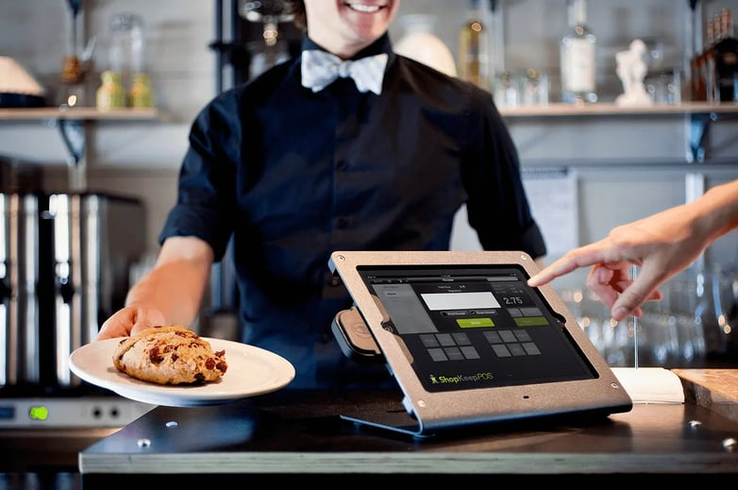
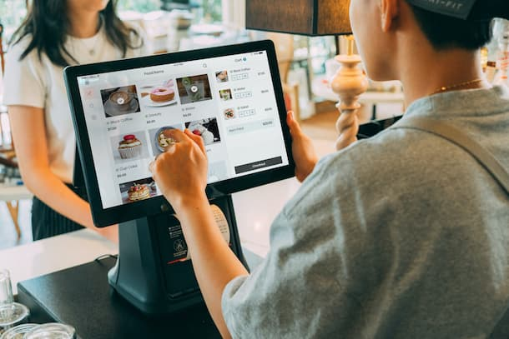
Key Components of Restaurant Management System
💳
📦
Point of Sale (POS) System
.
Order Management System
Central hub for processing customer transactions.
Manages orders from various channels (in-person, online, third-party apps).
🍽️
Reservation Management
📜
Menu Management
Ensures efficient use of dining space and customer satisfaction.
Provides dynamic control over menu offerings.

Slide 4
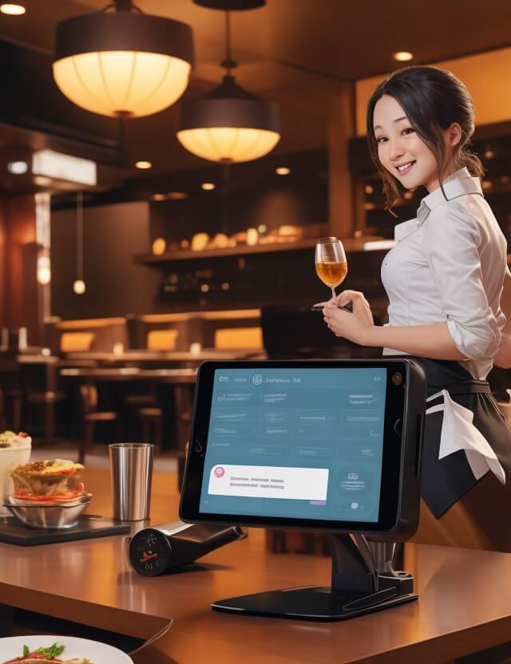
Features and System Architecture
1
List major features
2
System Architecture
Order Management.
Table Reservation.
Inventory Management.
Billing and Payment Integration.
Customer Feedback and Loyalty Programs.
Employee Management.
Show a diagram or flowchart of the system:Frontend (User Interface).
Backend (Database and Application Logic).
Integrations (POS systems, payment gateways, etc.).

Slide 5
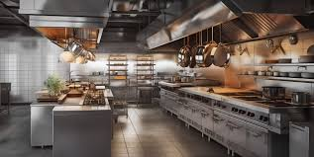
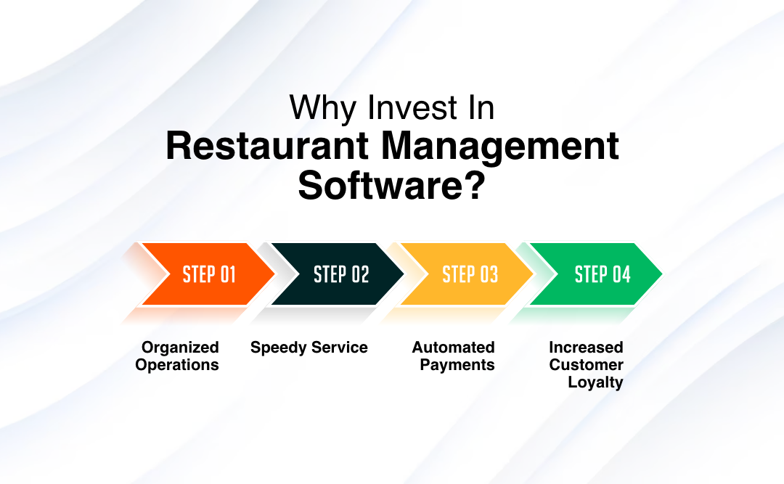
Restaurant management objectives
Workflow
Benefits
Customer places an order or reservation.Staff receives and processes the order.System tracks inventory usage.Bills are generated and processed.
Reduced operational errors.Faster service.Real-time inventory tracking.Enhanced customer satisfaction.
Technology Stack
Challenges and Solutions
Programming languages (e.g., Java, Python, PHP).
Database (e.g., MySQL, MongoDB).Frameworks (e.g., Django, Laravel).
Tools (e.g., POS systems, cloud hosting).
High initial setup costs.Staff training requirements.
Data security concerns.
Scalable options.
Intuitive user interfaces.
Regular software updates.

Slide 6
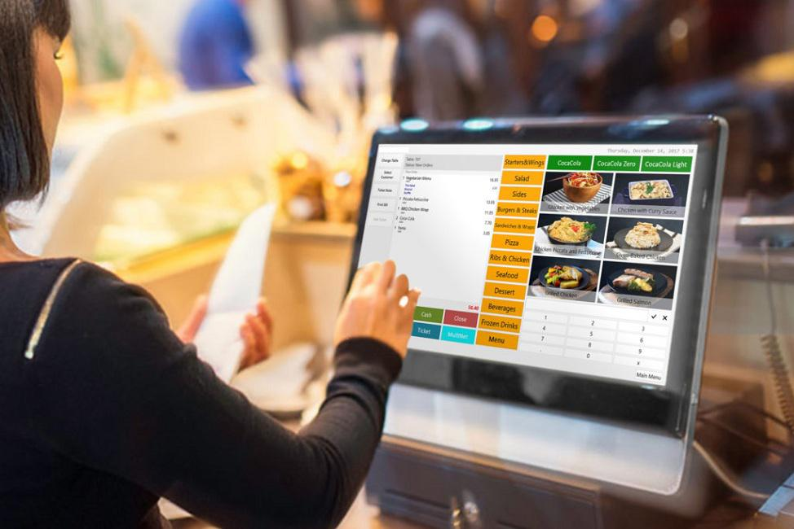
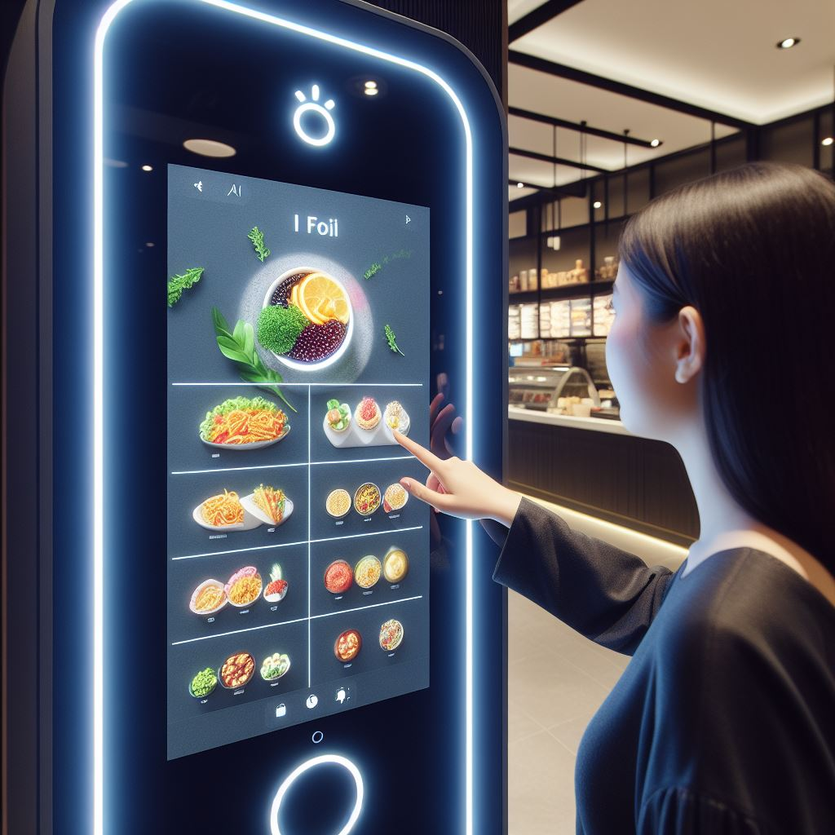
Restaurant’s food prices , quality and offers
1
Restaurant awards and recognitions
Chef’s personality in the cuisine.
Consistency across visits ,Mastery of flavor and cooking techniques.
2
Restaurant food prices and quality comparisons?
High-quality ingredients, exceptional service, and intricate dishes. Prices are premium.
To compare we can chick in Google Reviews
3
Restaurant deals, offers, or discounts in your area?
Offers exclusive deals such as 50% off at select restaurants
Features deals like 15% off on bills over ₹1000

Slide 7
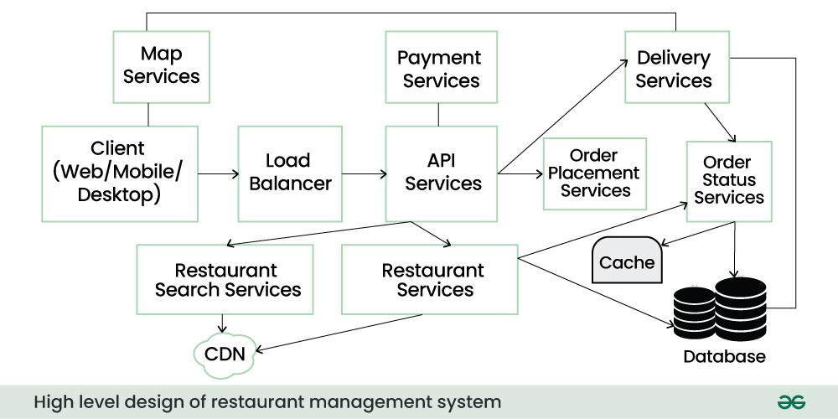




Real-Time Monitoring and Alarm Triggering
Continuous Surveillance
1
Round-the-clock monitoring of your home's security status
Instant Alerts
2
Receive immediate notifications of potential security breaches
Remote Access
3
Monitor and manage your home's security from anywhere using your smartphone
Automated Response
4
Trigger pre-defined actions, such as sounding alarms or notifying authorities

Slide 8
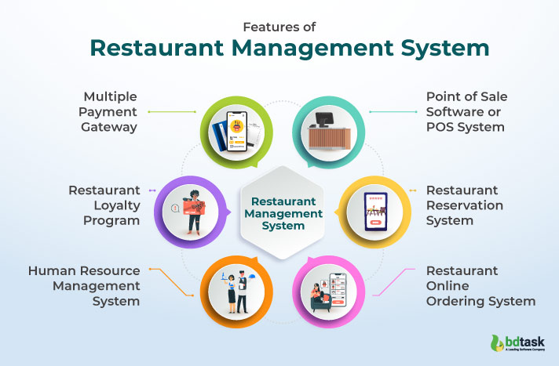
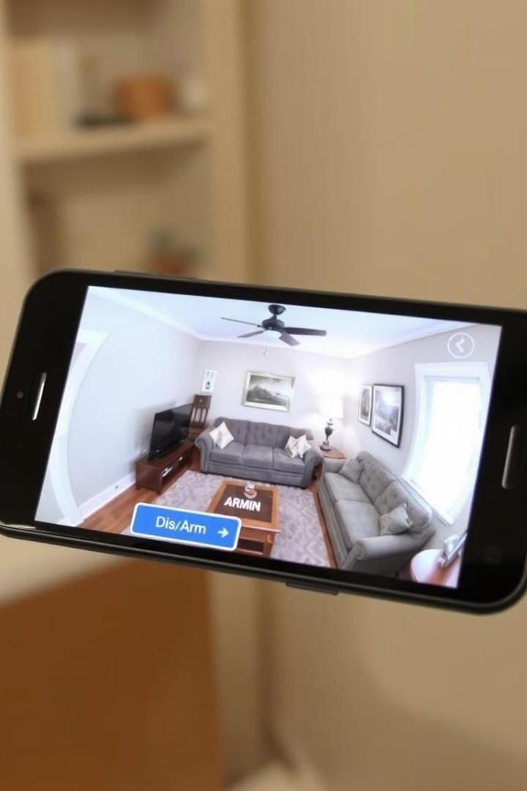




User Interface and Mobile Integration
Intuitive Dashboard
Provide a user-friendly interface for monitoring and controlling the security system
Mobile App Integration
Develop a companion mobile app for remote access and management of the security system
Voice Command Support
Integrate voice control capabilities for hands-free operation and enhanced convenience
Personalized Settings
Allow users to customize system preferences and notification settings to their preferences

Slide 9
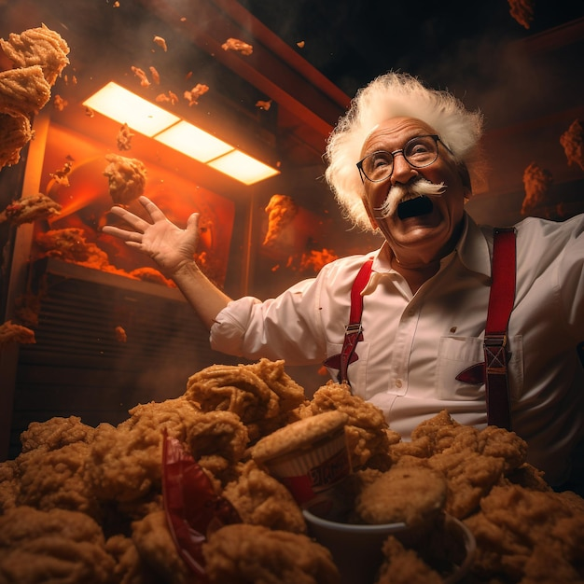
Restaurant Services
Services
Dining Services
Dine-in , Takeaway , Delivery , Drive-thru
Customer Experience
Table Reservations: Online or phone-based booking services.
Ambiance: Focus on decor, lighting, music, and overall environment.
Food Presentation: Creative and visually appealing dish arrangements.
Customer Support
Feedback Systems: Encouraging customer reviews and addressing complaints.
Special Requests: Catering to dietary restrictions or allergies.

Slide 10
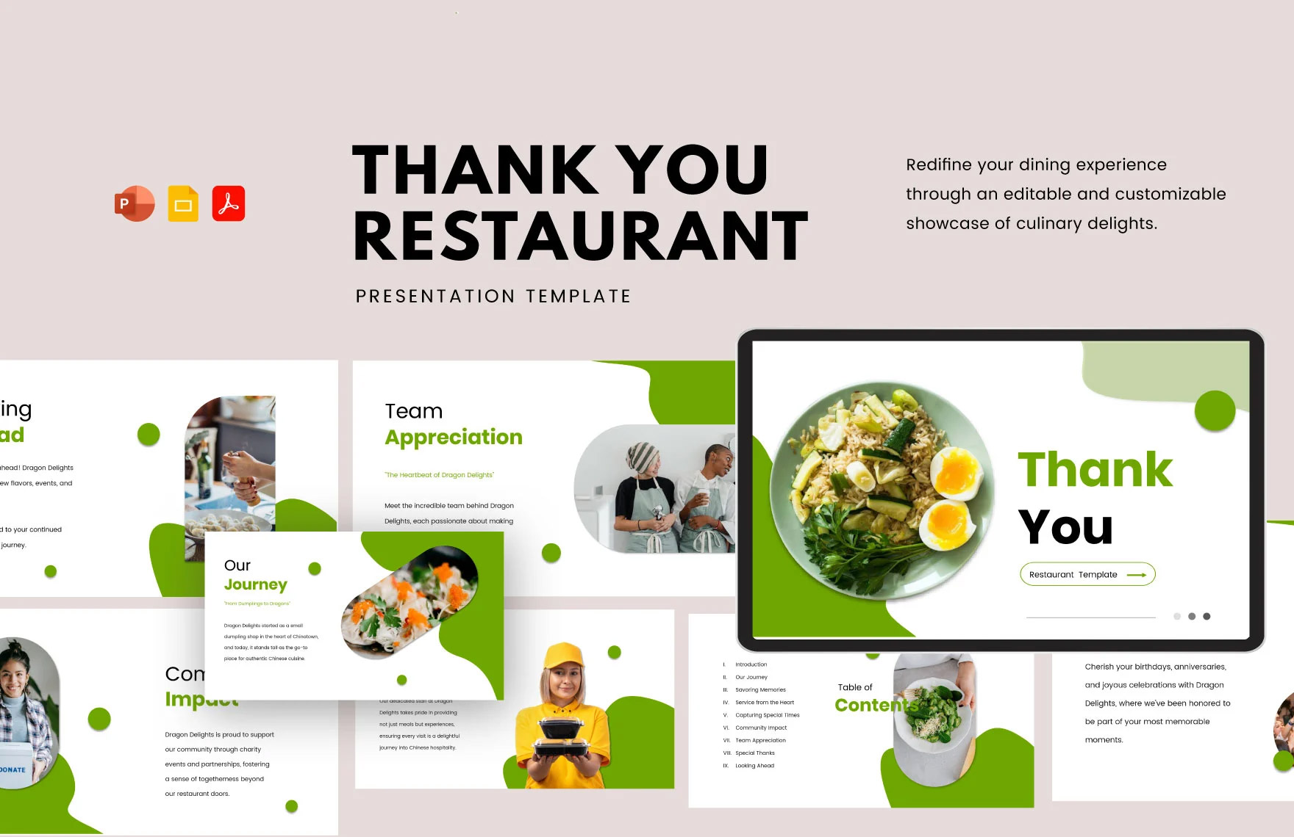
Challenges and Future Enhancements
Cybersecurity
1
Implement robust security measures to protect the system from cyber threats
Energy Efficiency
2
Optimize sensor and device power consumption to minimize energy usage
Scalability
3
Design a flexible architecture to accommodate future growth and integration of new technologies
Voice Integration
4
Enhance the user experience with advanced voice control and natural language processing

